Slide 1

“Emotions Classification Based on Feedback for an Event Planning Company using Text Classification”
INTERNSHIP
- YASHAS M

Slide 2
TABLE OF CONTENTS
Introduction
Problem Statement.
Dataset overview
Modeling Approach
Models used and Hyperparameter Tuning
Results
Conclusion

Slide 3
PROBLEM STATEMENT
EVENT PLANNERS –function and programs organizers.
Client Satisfaction Importance and Critical for success and long-term relationships in event planning.
After the every event Feedback is Collected through surveys, emails, social media, and online reviews.
Manual Analysis Issues: Labor-intensive, subjective, inefficient, and prone to misinterpretation.
Develop a machine learning-based system for automated emotion classification in client feedback
Scalable and efficient analysis, deeper insights, proactive issue resolution, and enhanced client satisfaction and retention.

Slide 4
DATA OVERVIEW
Dataset consist of following column:
1.Label:Integer
2.Text:String
Total length : 16001
Labels
The count of sadness is: 4666,joy is: 5362, love is: 1304,anger is: 2159,fear is: 1937,surprise is : 572.
The dataset is imbalanced and we should perform upsampling techniques.

Slide 5
Data Preprocessing
• Lower Case
• Remove links
• Remove next lines (\n)
• Words containing numbers
• Extra spaces
• Special characters
• Removal of stop words
• Stemming
• Lemmatization

Slide 6
Modeling approach
1. Data (Text) Preprocessing:
• Lower Case
• Remove links
• Remove next lines (\n)
• Words containing numbers
• Extra spaces
• Special characters
• Removal of stop words
• Stemming
• Lemmatization
2. Featuring Engineering:
• Convert the Text corpus to a matrix of word counts. (Vectorize the Text data)
Eg: Use Tf-IDF

Slide 7
Modelling approach
3. Model Building:
1. Divide the dataset in to Train (70%), Test (20%) and Validation (10%) datasets.
2. Build at least 3 classification models
Step 1: Build model 1 and generate the classification report (Performance metrics using ConfusionMetrics) for both Training and Test datasets.
Step 2:
• Use grid search or binary search for Hyperparameter Tuning.
• Use atleast 2 values for each hyperparameters.
• Choose the best model parameters based on grid search and generate the classification report (Performance metrics using Confusion Metrics) for both Training and Test datasets.
Step 3: Repeat step 1 and 2 for Model 2 and Model 3 as well.
Step 4: Now choose the final model based on the classification report (Performance metrics using Confusion Metrics) for both Training, Test and validation datasets.
4. Data Visualization: Input and Output plots

Slide 8
Models used and Hyperparameter Tuning.
Models used:
Random Forest: It uses decision tree and generates many decision trees .Provides valuable insights into feature importance and demonstrates robustness in classification tasks.
Hyper-parameters used n_estimators , max_depth .
Support Vector Machine (SVM): It finds the hyperplane (best solution),Achieves the highest test accuracy and generalization capability, making it the best-performing model.
Hyper-parameters used C , kernel
XGBoost: Offers balanced performance with effective handling of complex data and managing overfitting.
Hyper-parameters used n_estimators, learning_rate.

Slide 9
Hyperparameter tuning
Logistic Regression: Demonstrates solid performance with high interpretability, ideal for understanding linear relationships in the data.
Hyper parameters used C,solver,max_iter.
GRID SEARCH
Grid Search systematically evaluates multiple combinations of hyperparameters through cross-validation to identify the best-performing set for each model.
STEPS INVOLVED:
Define the parameter grid.
Cross-validation.
Model fitting.
Performance evaluation.
Model selection.

Slide 10
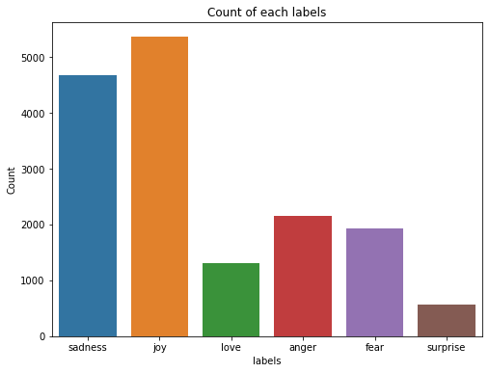
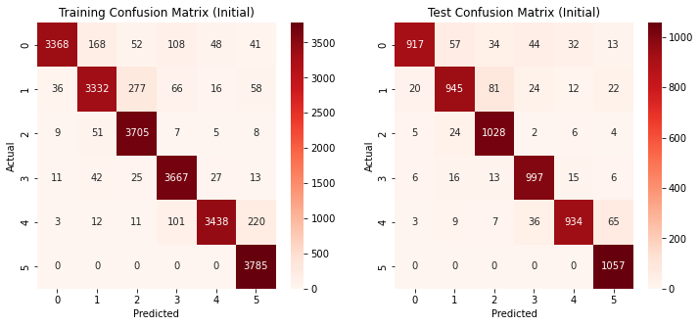
RESULTS
Label wise comparisions of the dataset using bar graph
Confusion Matrix of the Xgboost algorithm after hyperparameter tuning.

Slide 11
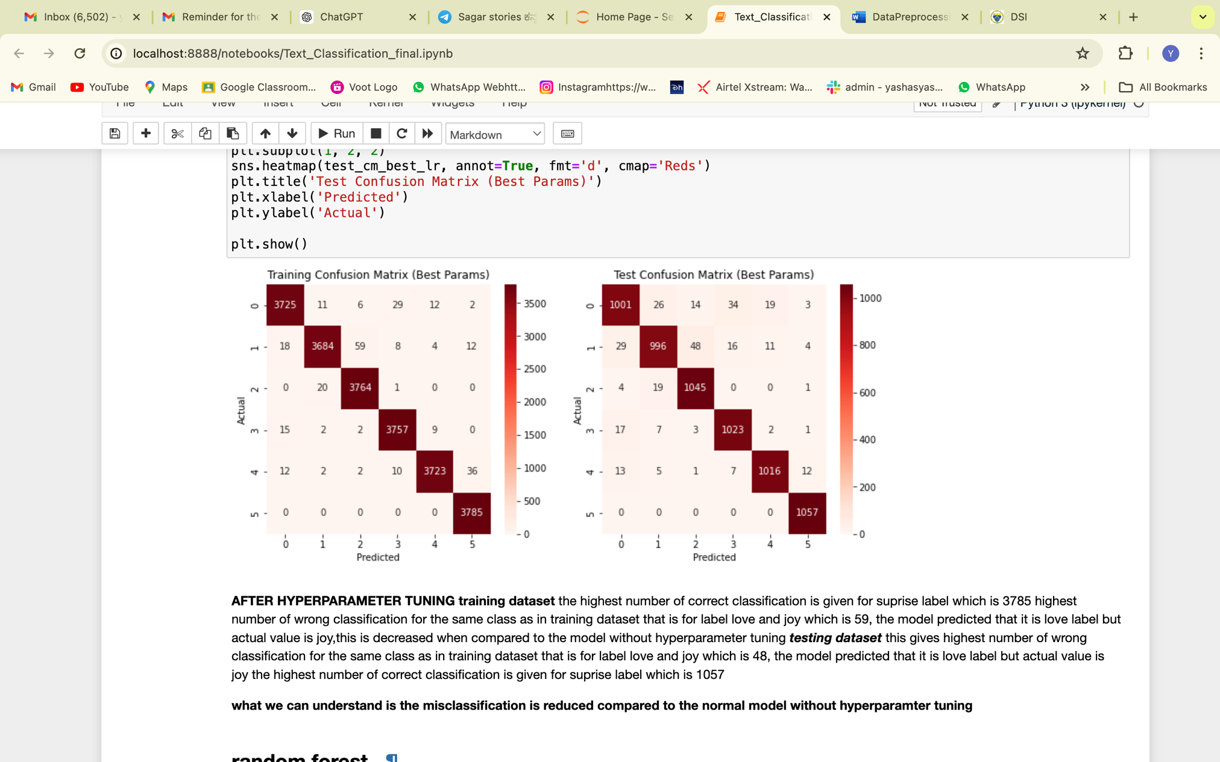
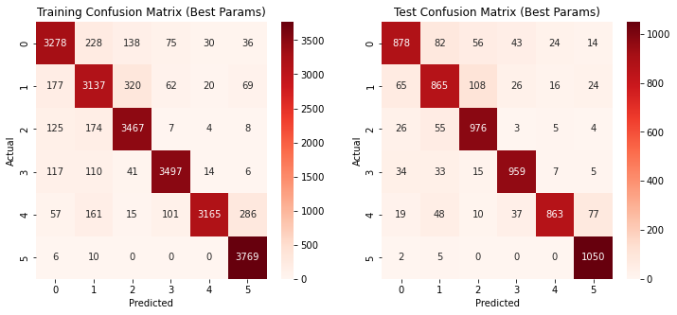
RESULTS
The Confusion matrix of the logistic regression after hyperparameter tuning.
The confusion matrix of the random forest algorithm after the hyperparameter tuning

Slide 12
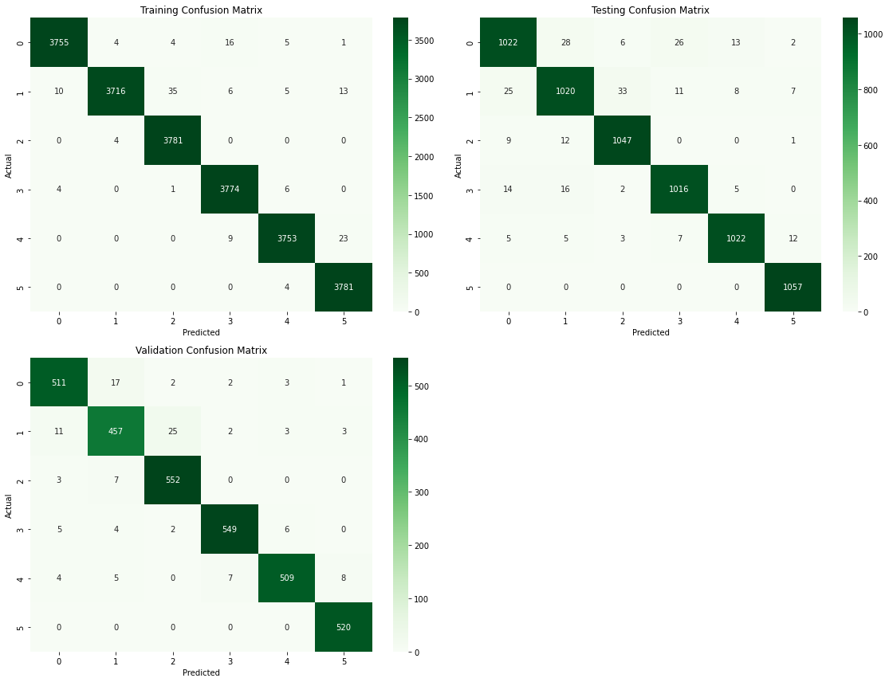
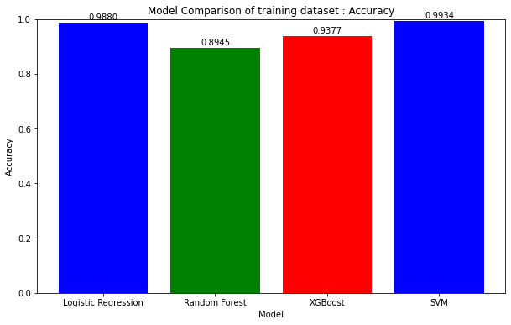
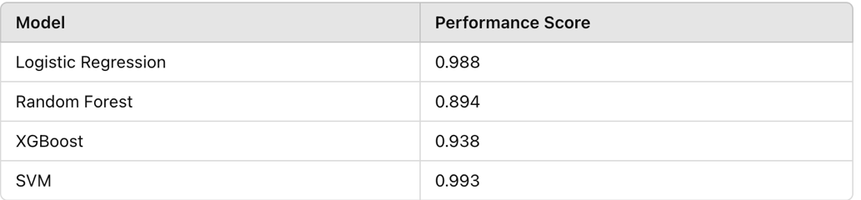
RESULTS
Confusion matrix of the SVM algorithm after hyperparameter tuning
Model wise comparision based on Accuracy for training dataset

Slide 13
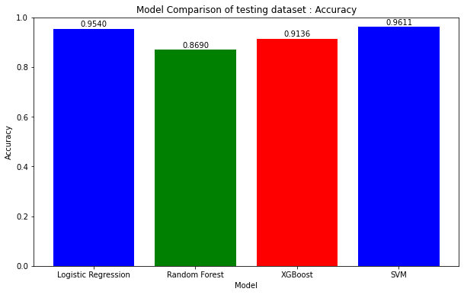
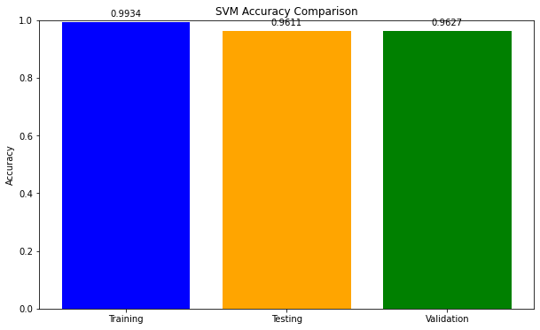
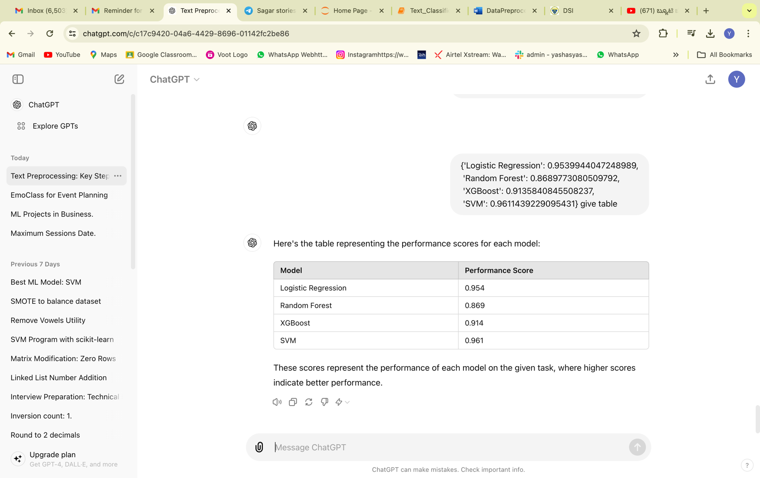
Results
.
.
SVM model comparision between Training ,Testing and Validation dataset
Model wise comparision based on Accuracy for testing dataset

Slide 14
RECOMMENDATION OR RESOLUTION
Implemented SVM as the primary emotion classification model due to its high accuracy.
By leveraging these models, the company can promptly address negative feedback, improve service quality, and enhance overall client satisfaction and retention.
Regular performance monitoring and user feedback collection will be essential for ongoing system improvement and effectiveness.
We can develop an integrated system with standardized data pipelines, intuitive dashboards, and real-time alert systems using PowerBI and Tableau to make it better in future.

Slide 15


